Slide 1
Delta Live Tables
Why we need Delta Live Tables?

Slide 2
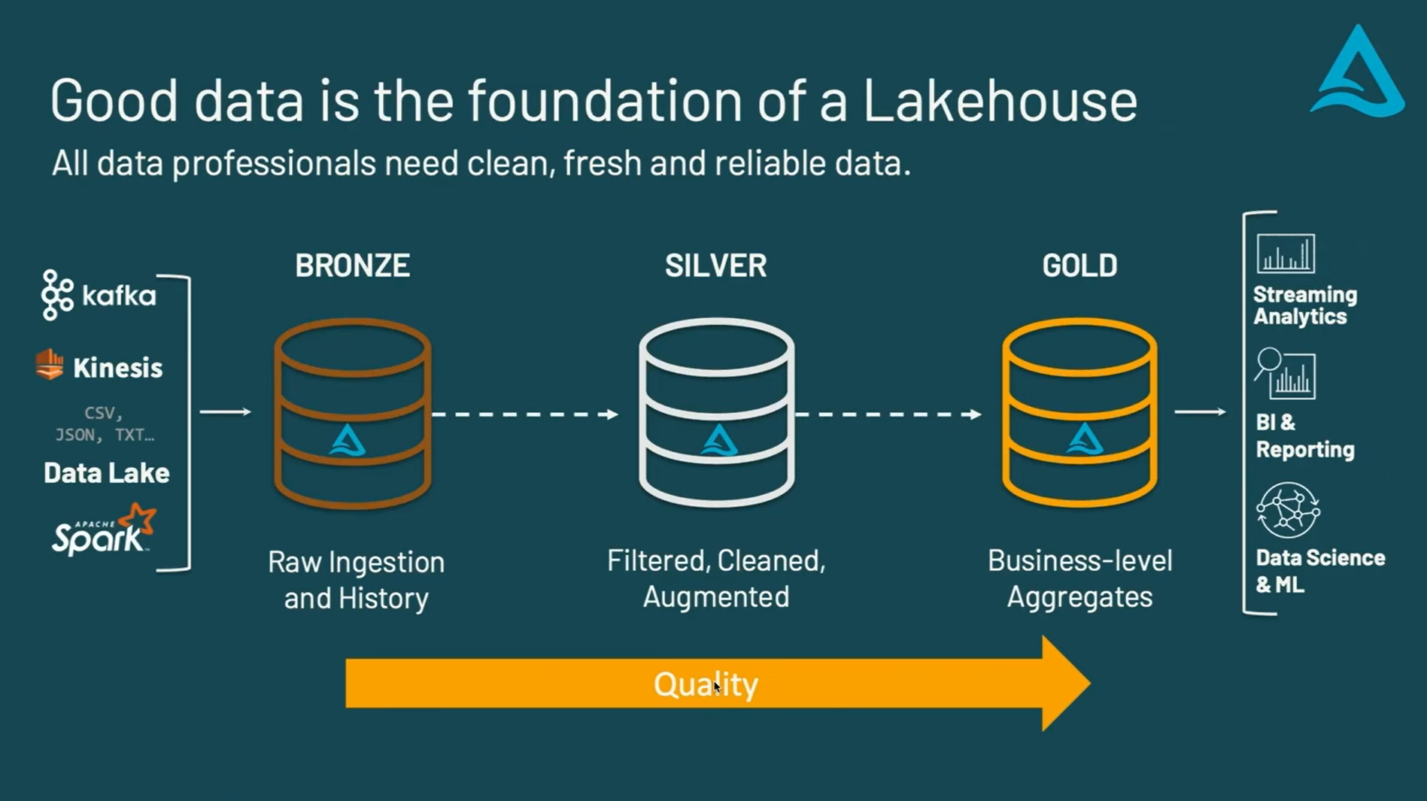

Slide 4
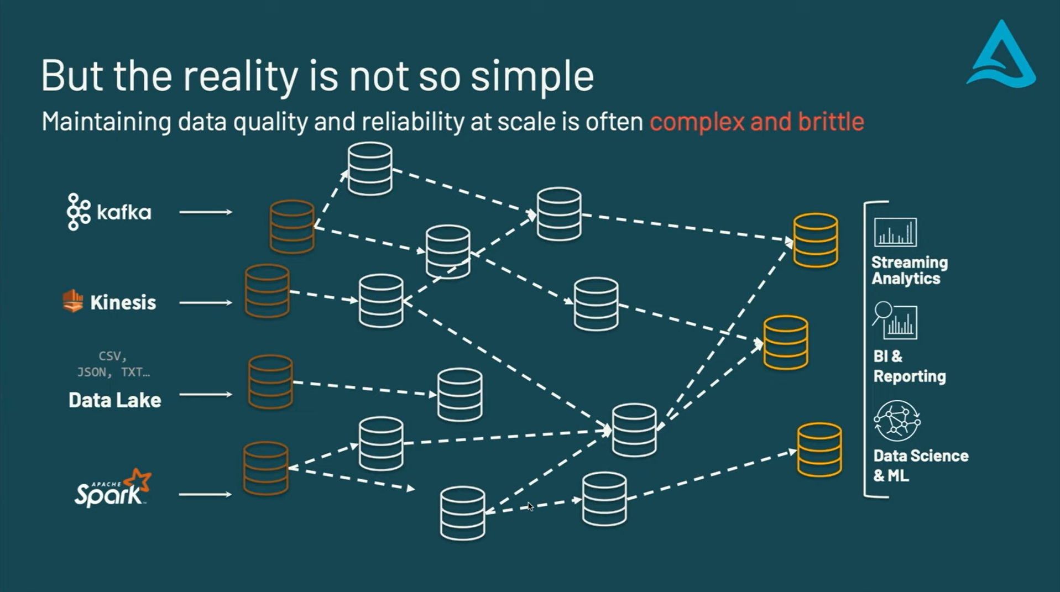

Slide 5
So,
We have massive amount of data
We need analysis
Not daily but update every minute
We have complex tooling and we need to manage
Dependency management
Quality checks
Version control
Deployment infrastructure and many more things

Slide 6
Where you should focus your time
is getting value from data
This is where DLT comes into the picture

Slide 7
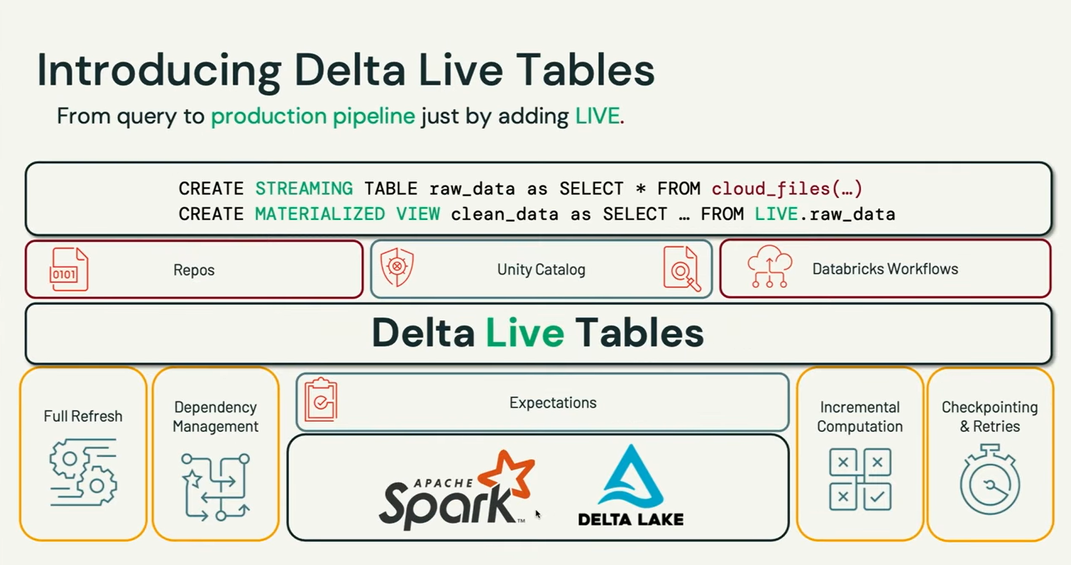

Slide 8
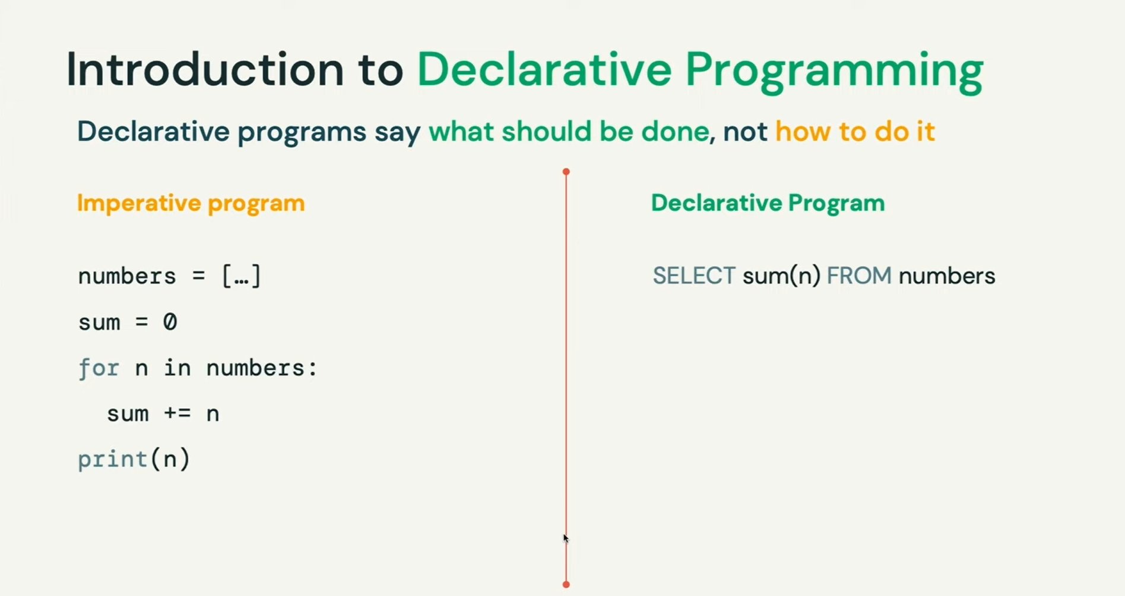
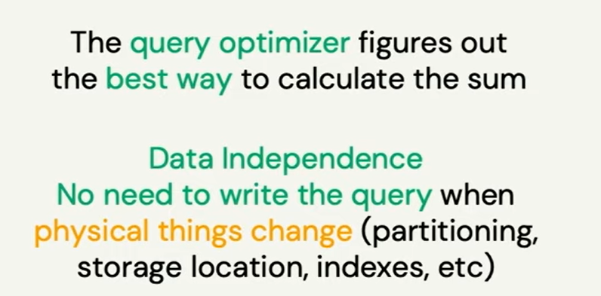

Slide 9
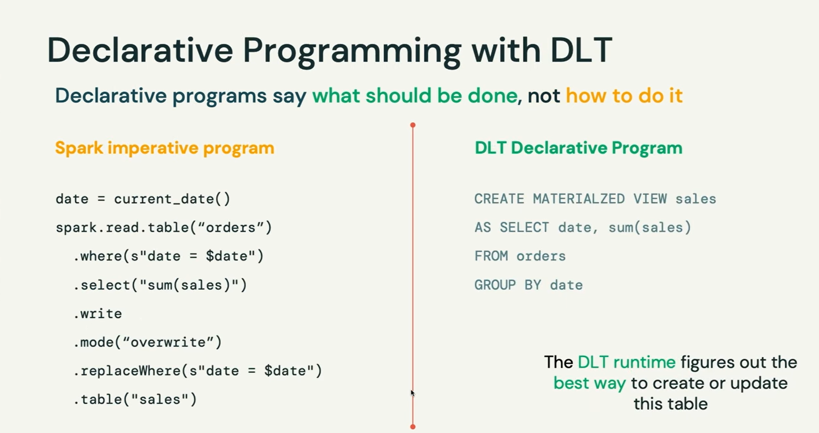

Slide 10
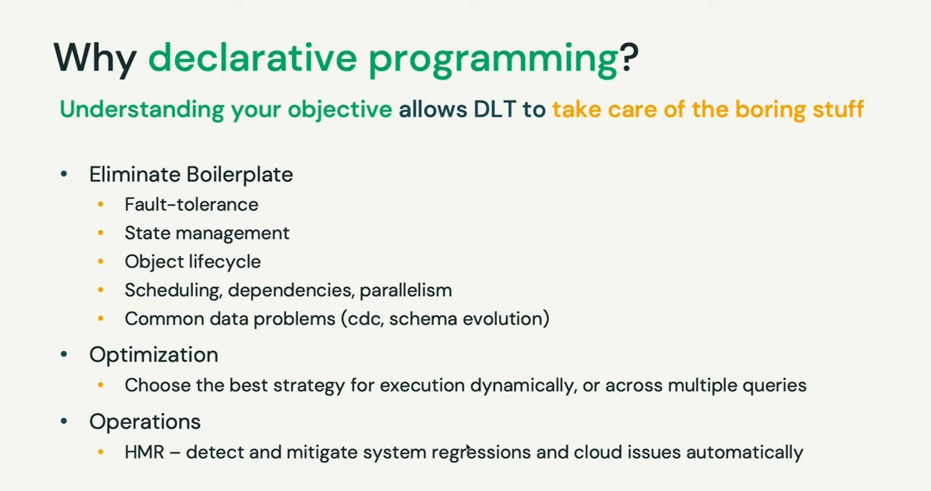
Notes:
CDC- Change data capture
SCD 1 and SCD 2 - Slowly changing dimentions

Slide 11
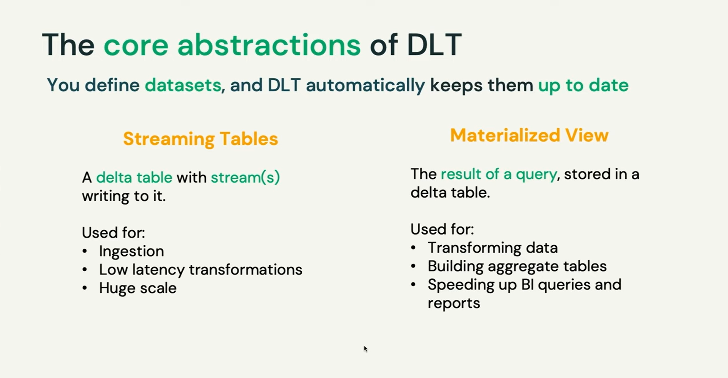

Slide 12
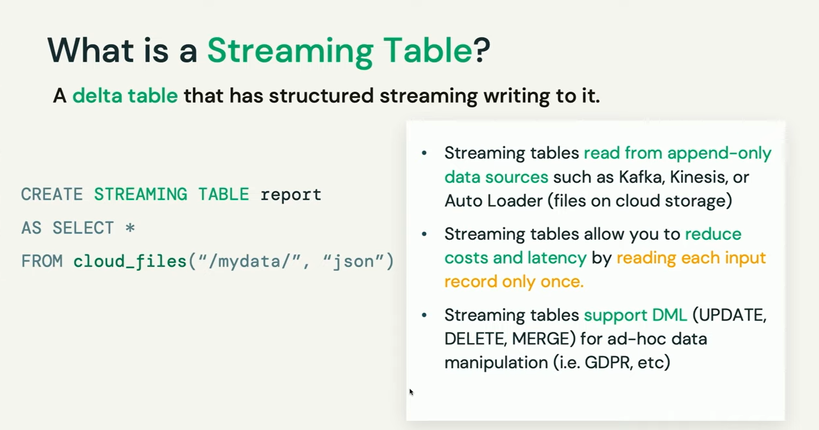

Slide 13
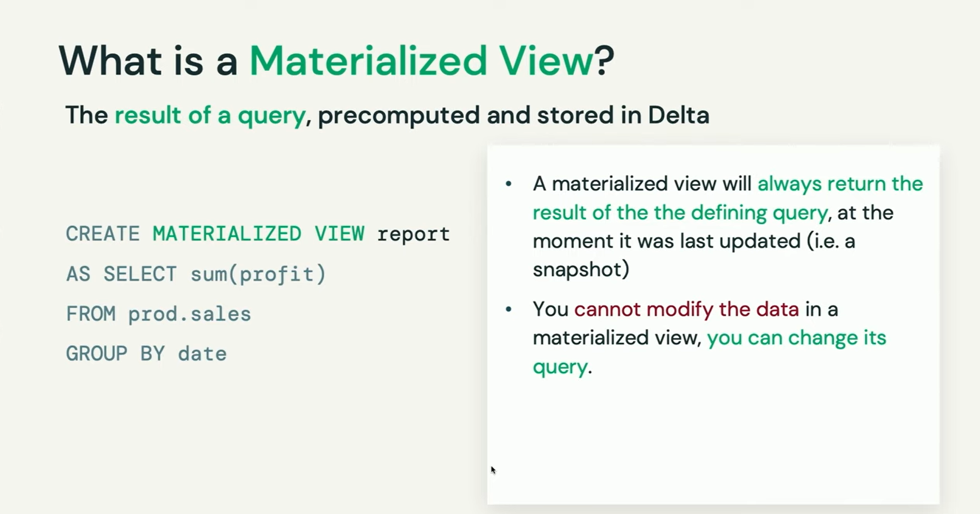

Slide 14
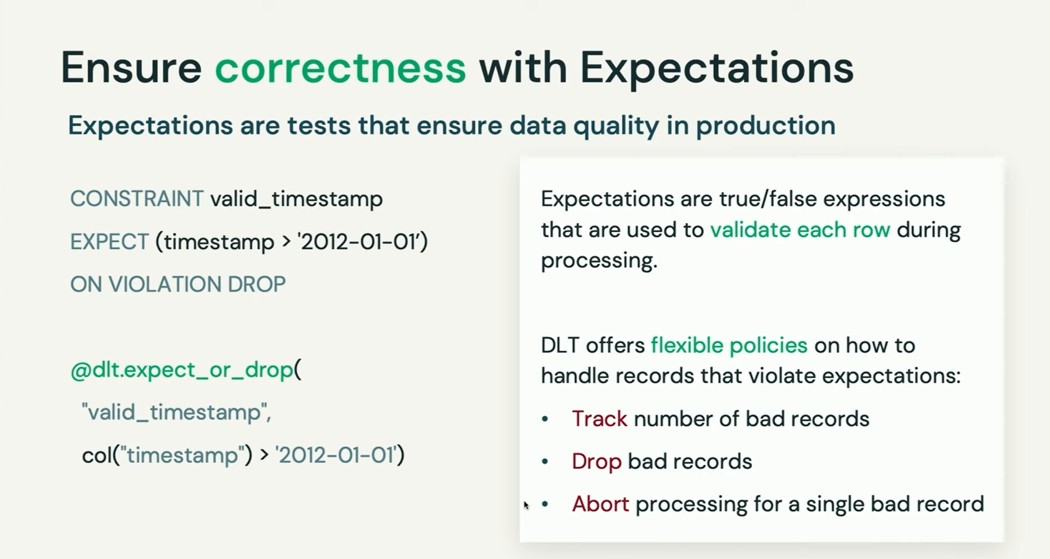

Slide 15
Delta Live Tables
What is Delta Live Tables?
It’s a declarative framework with pre built functions

Slide 18
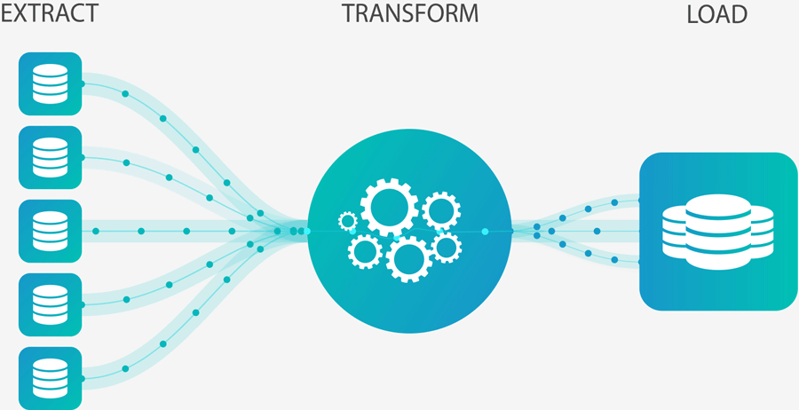
What is CDC?
What is SCD 1 and SCD 2?

Slide 19
CDC in Delta Live Table
DLT ahs out of the box feature called Apply Changes which currently support SCD1 and SCD2
If you want to use it first you need to know few things
1 – Target table
2 – Source Table
3 – Key
4 – Type of SCD [SCD1/SCD2]
5 – Sequence by

Slide 20
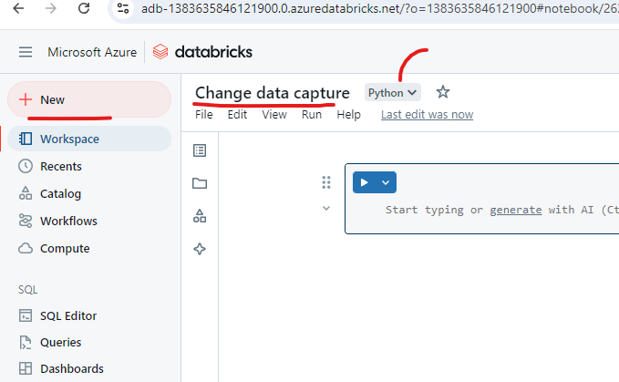

Slide 28
Delta Live Tables
Why we need Delta Live Tables?

Slide 32
So,
We have massive amount of data
We need analysis
Not daily but update every minute
We have complex tooling and we need to manage
Dependency management
Quality checks
Version control
Deployment infrastructure and many more things

Slide 33
Where you should focus your time
is getting value from data
This is where DLT comes into the picture

Slide 34
Delta Live Tables
What is Delta Live Tables?
It’s a declarative framework with pre-built functions

Slide 35
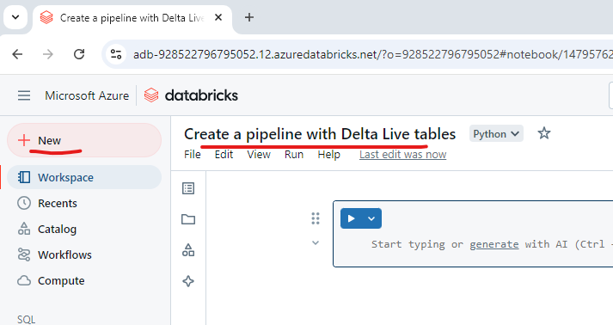

Slide 36
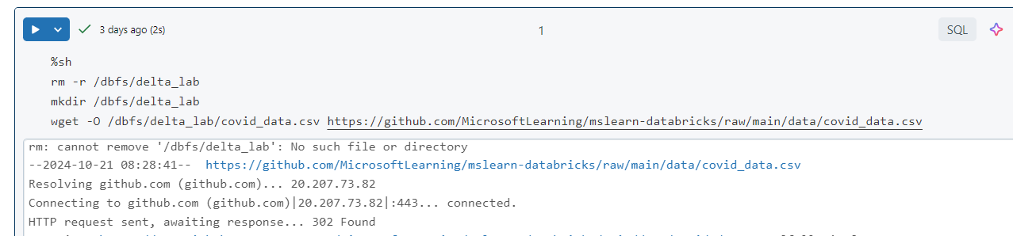

Slide 37
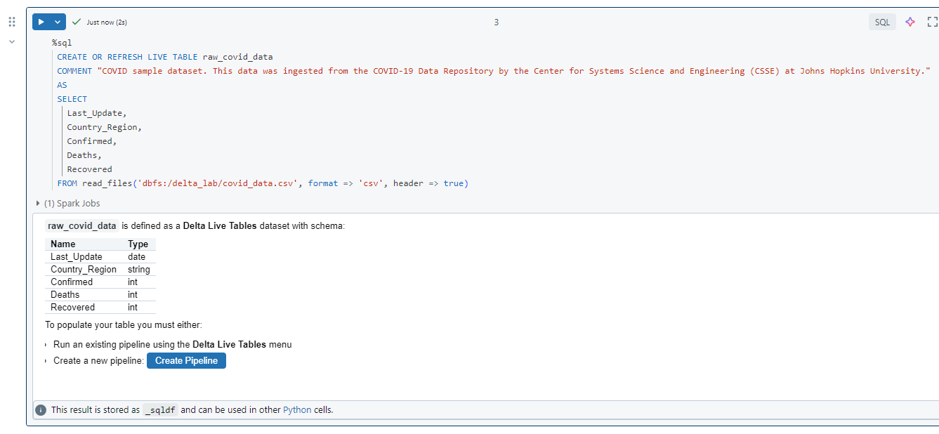

Slide 38
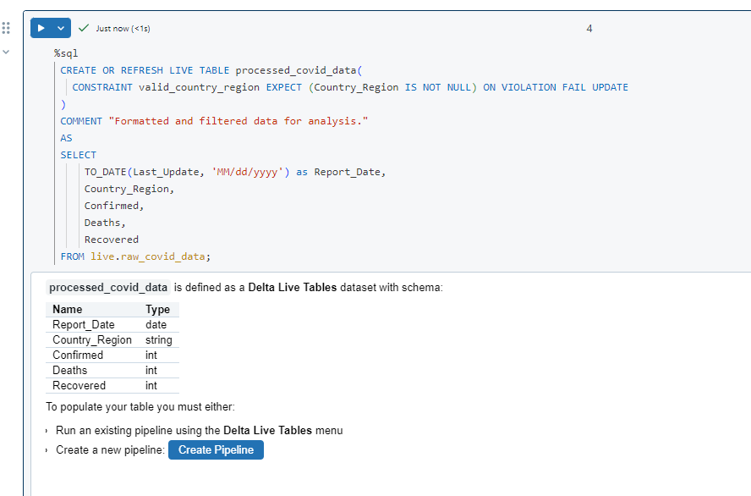

Slide 39
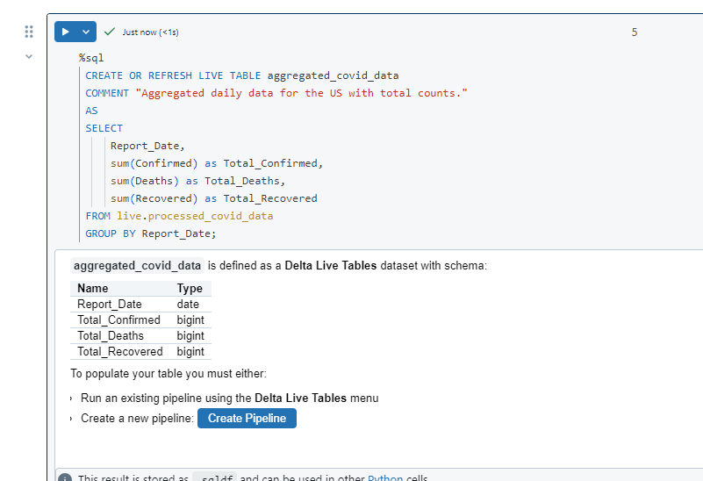

Slide 40
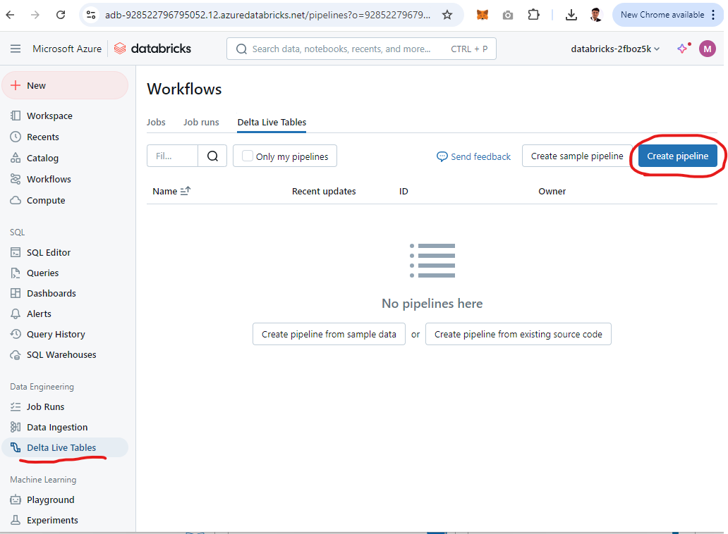

Slide 41
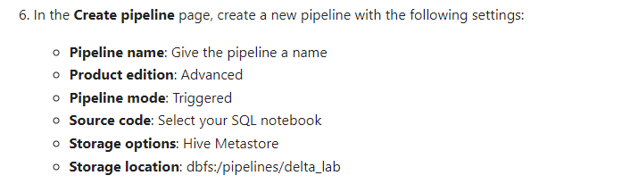

Slide 42
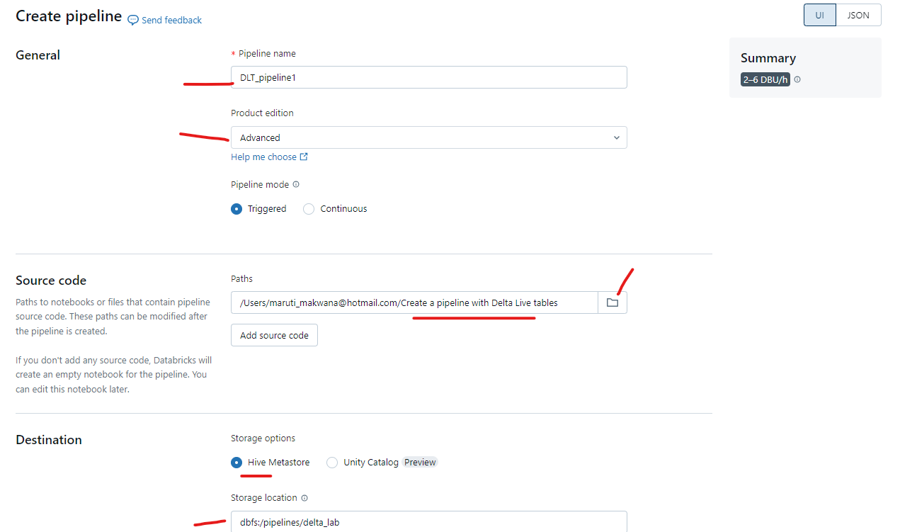

Slide 43
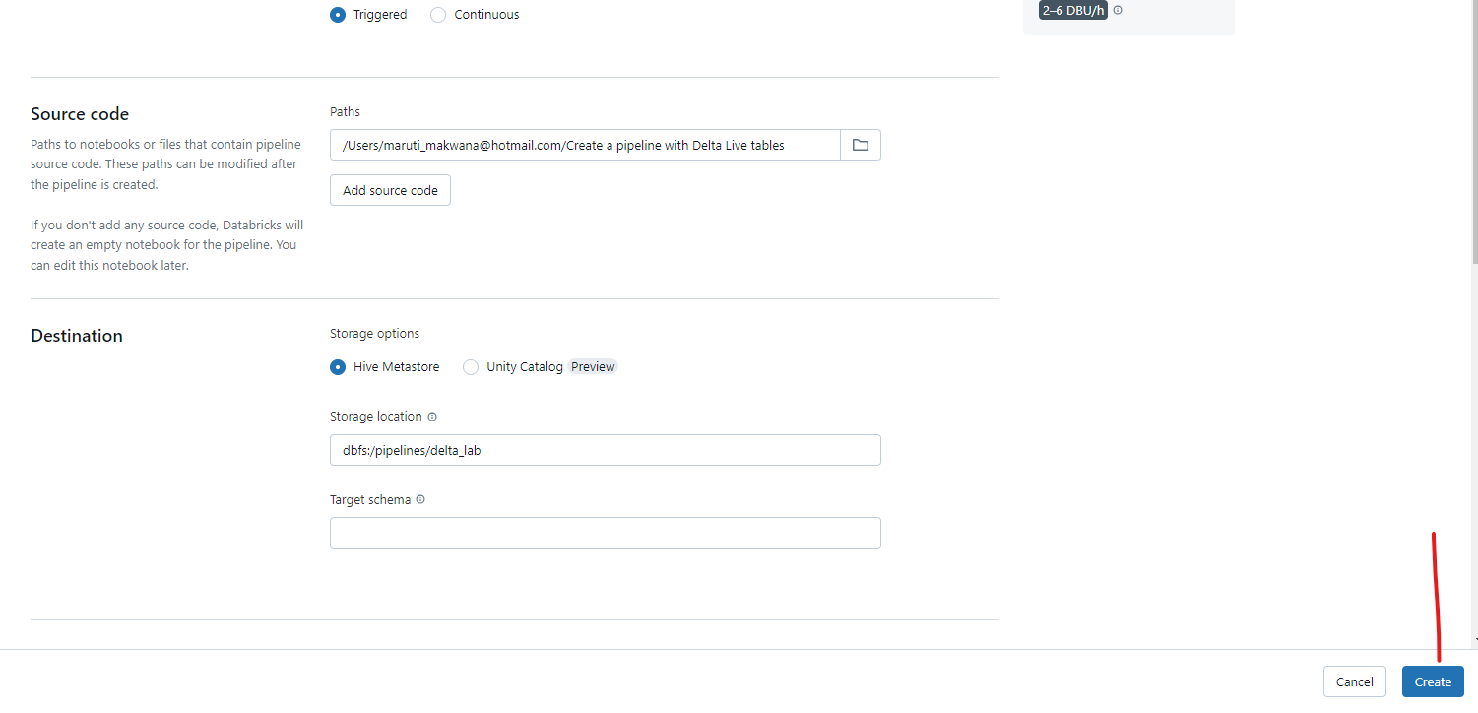

Slide 44
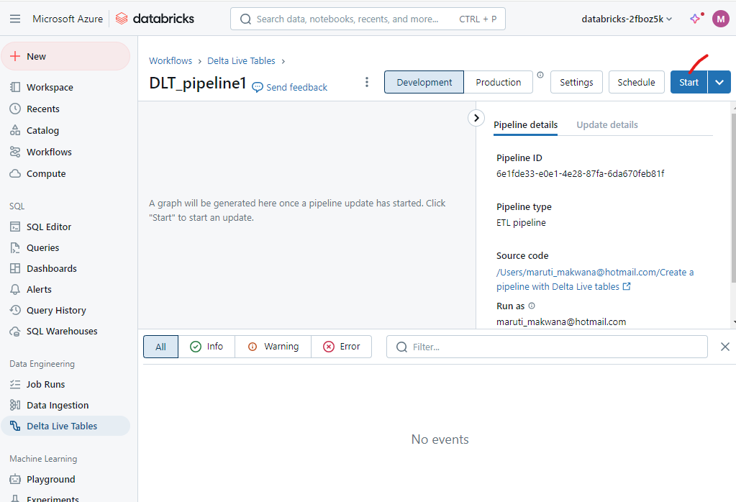

Slide 45
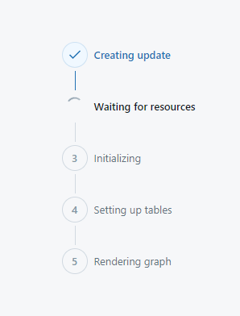

Slide 46
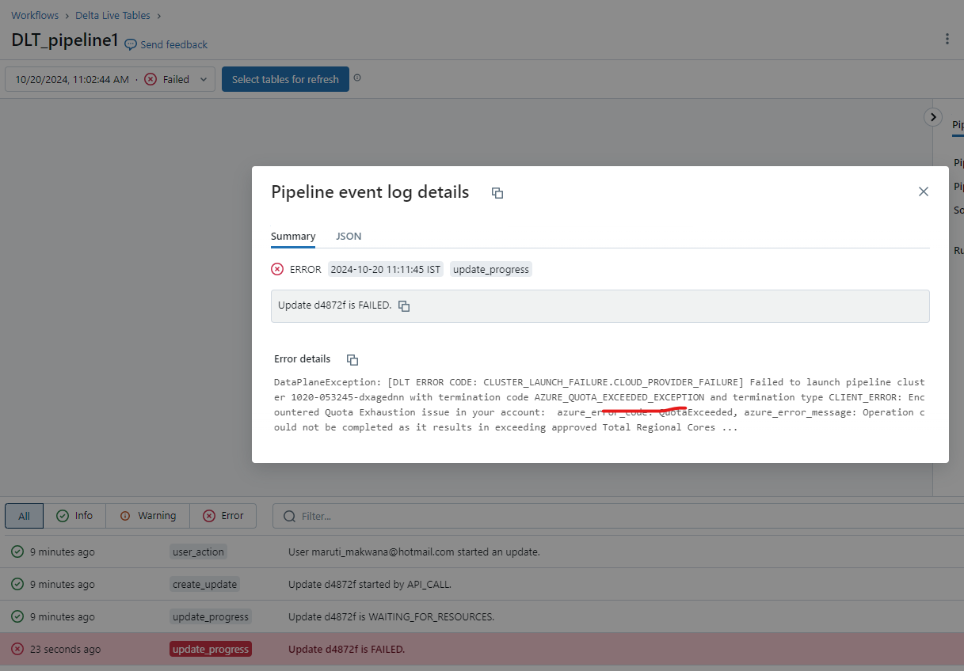

Slide 47
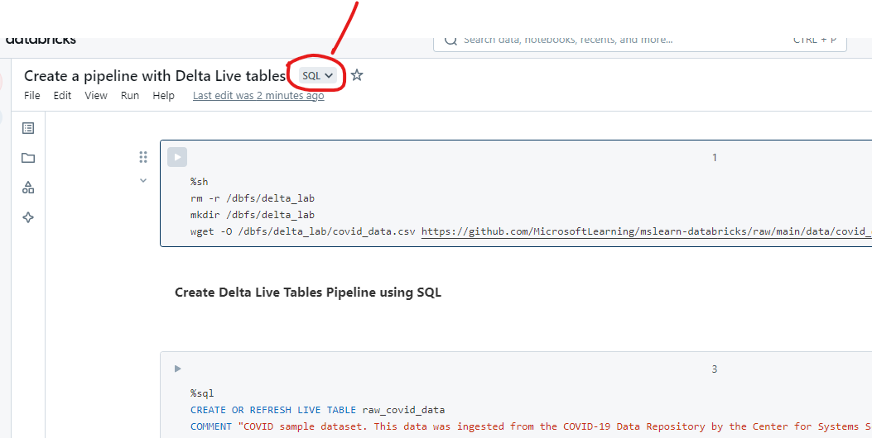
If initialize throw error please change notebook type to SQL

Slide 48
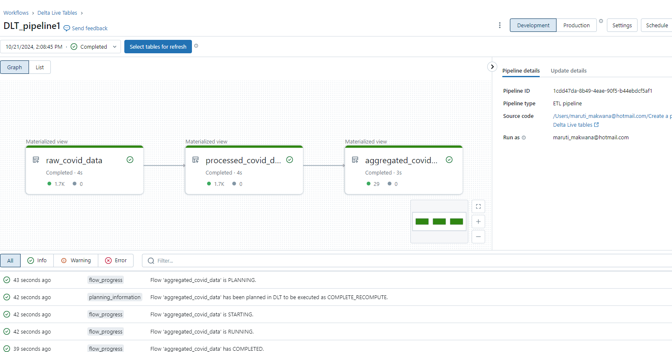

Slide 49
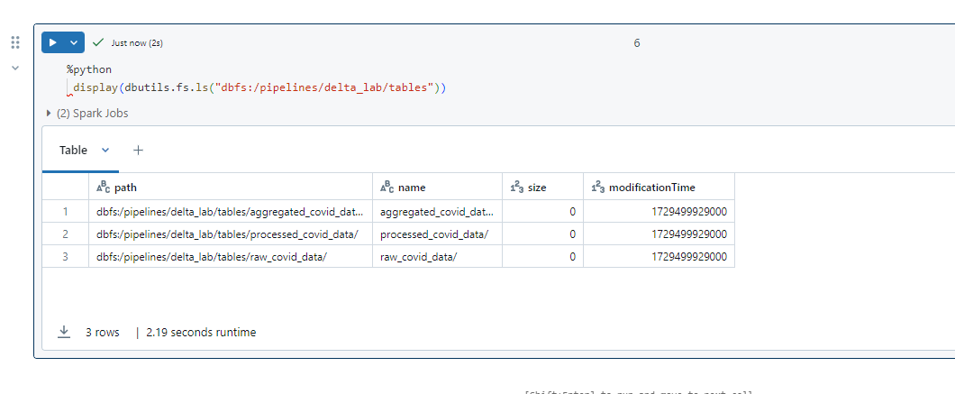
Once the pipeline is successfully executed, go back to the first notebook and verify that all 3 new tables have been created in the specified storage location with the following code:

Slide 50
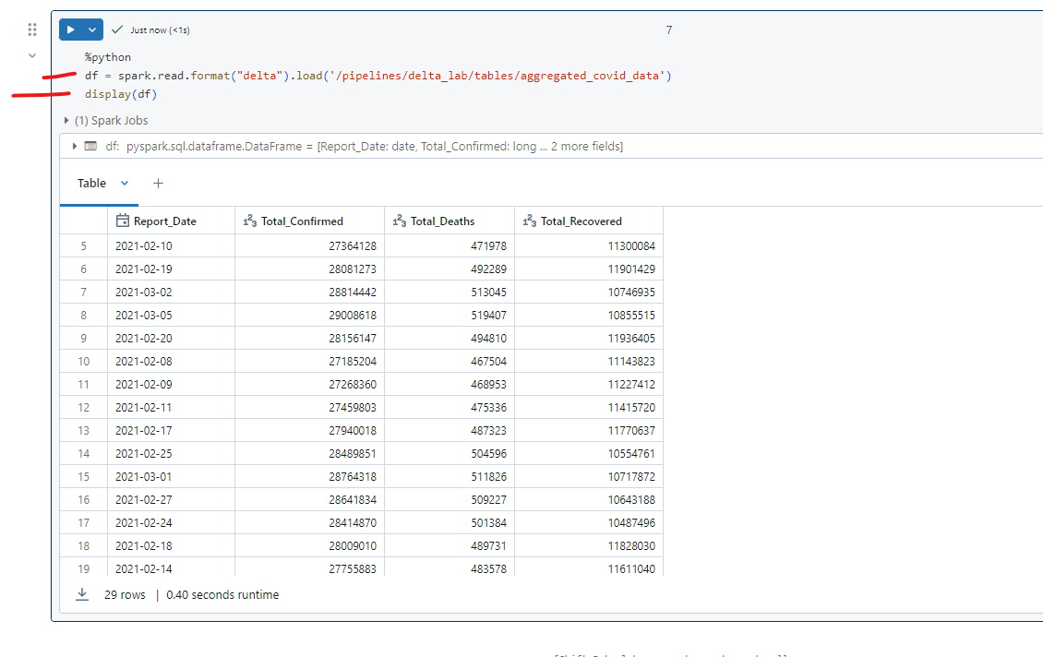
View results as a visualization

Slide 51
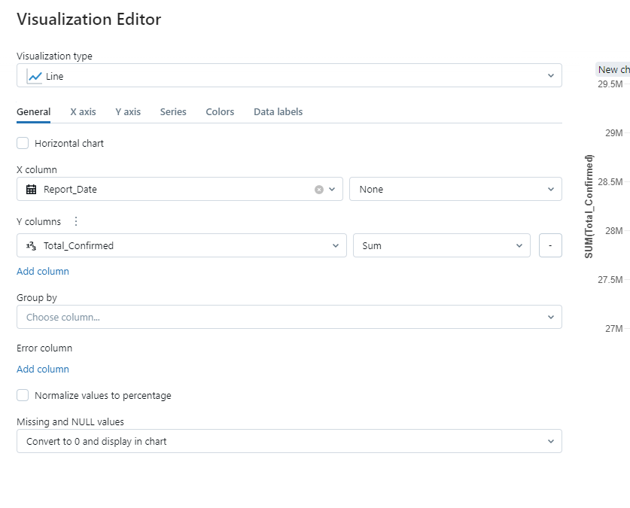

Slide 52
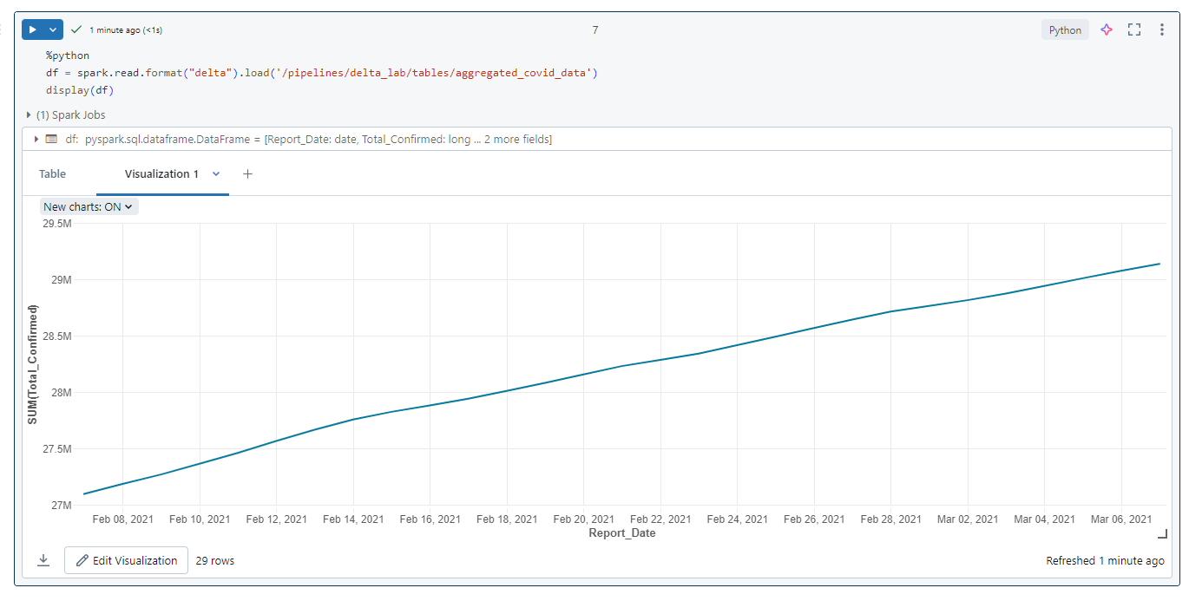

Slide 53
End-to-End Streaming Pipeline with Delta Live Tables in Azure Databricks

Slide 54
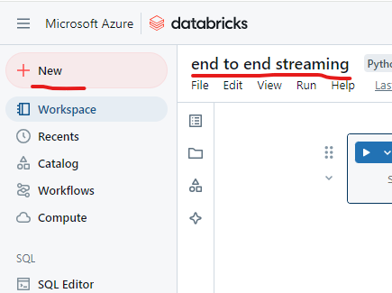

Slide 55
Use delta tables for streaming data
Delta lake supports streaming data. Delta tables can be a sink or a source for data streams created using the Spark Structured Streaming API. In this example, you’ll use a delta table as a sink for some streaming data in a simulated internet of things (IoT) scenario. In the next task, this delta table will work as a source for data transformation in real time.

Slide 56
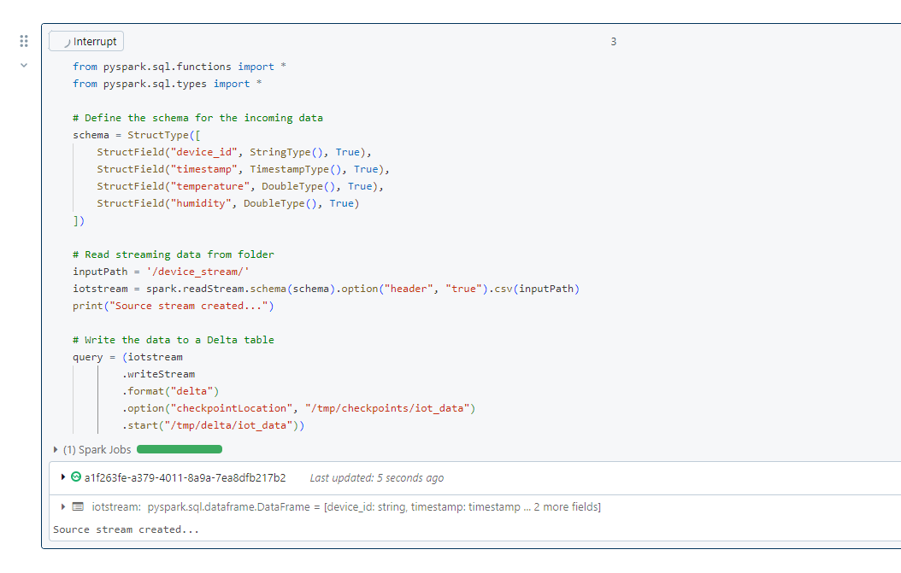

Slide 57
This delta table will now become the source for data transformation in real time.

Slide 58
Create a Delta Live Table Pipeline
A pipeline is the main unit for configuring and running data processing workflows with Delta Live Tables. It links data sources to target datasets through a Directed Acyclic Graph (DAG) declared in Python or SQL.

Slide 59
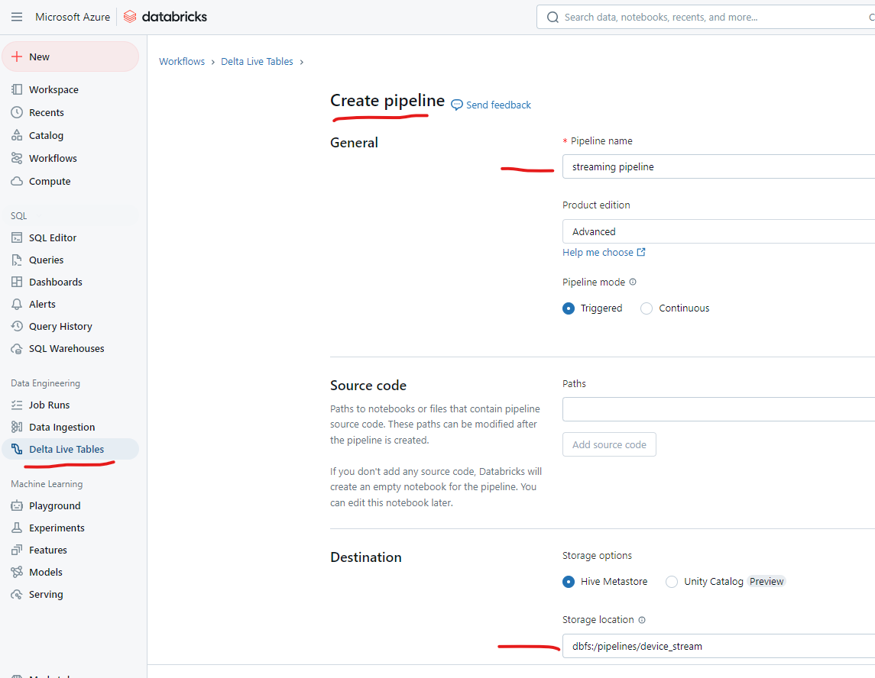

Slide 60
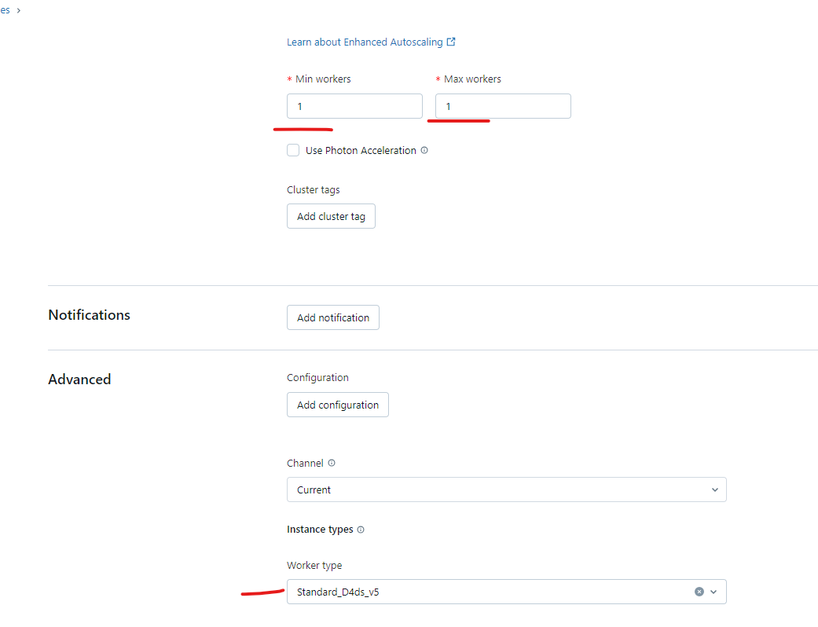

Slide 61
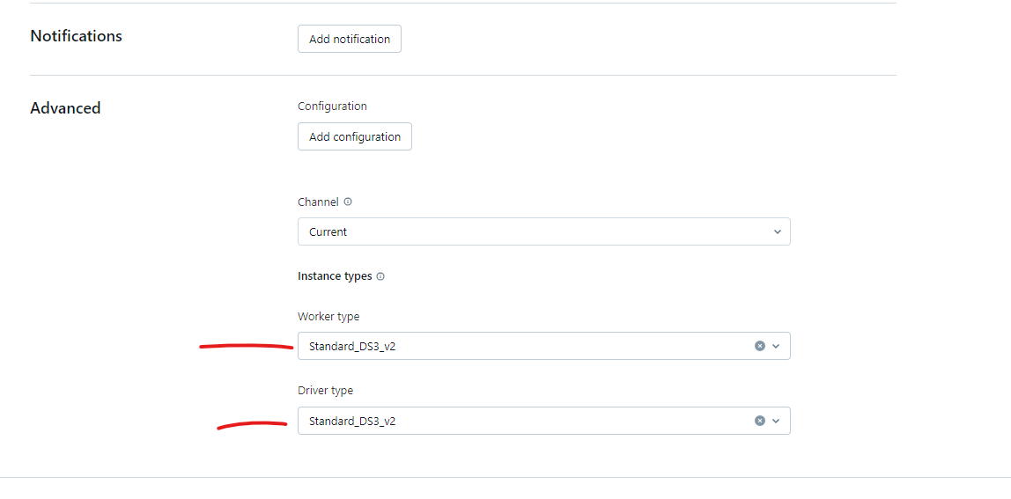
If above is not working then try to change worker and driver type like this

Slide 62
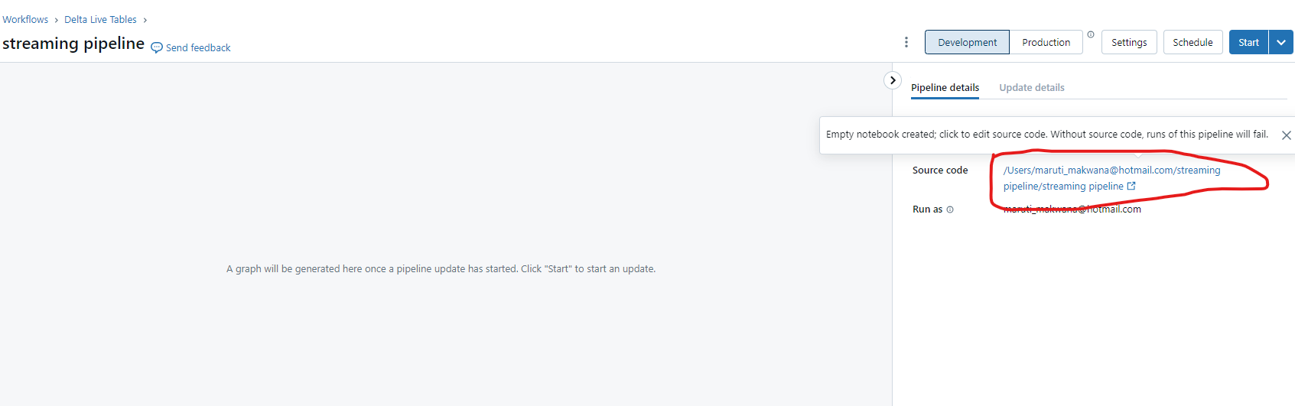
Once the pipeline is created, open the link to the blank notebook under Source code in the right-side panel:

Slide 63
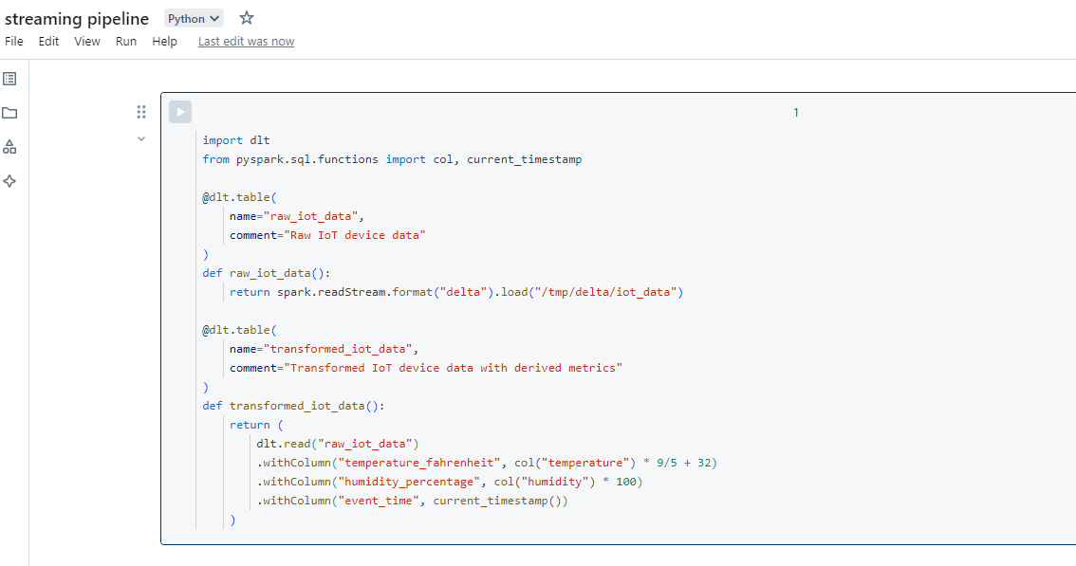
In the first cell of the notebook, enter the following code to create Delta Live Tables and transform the data:

Slide 64
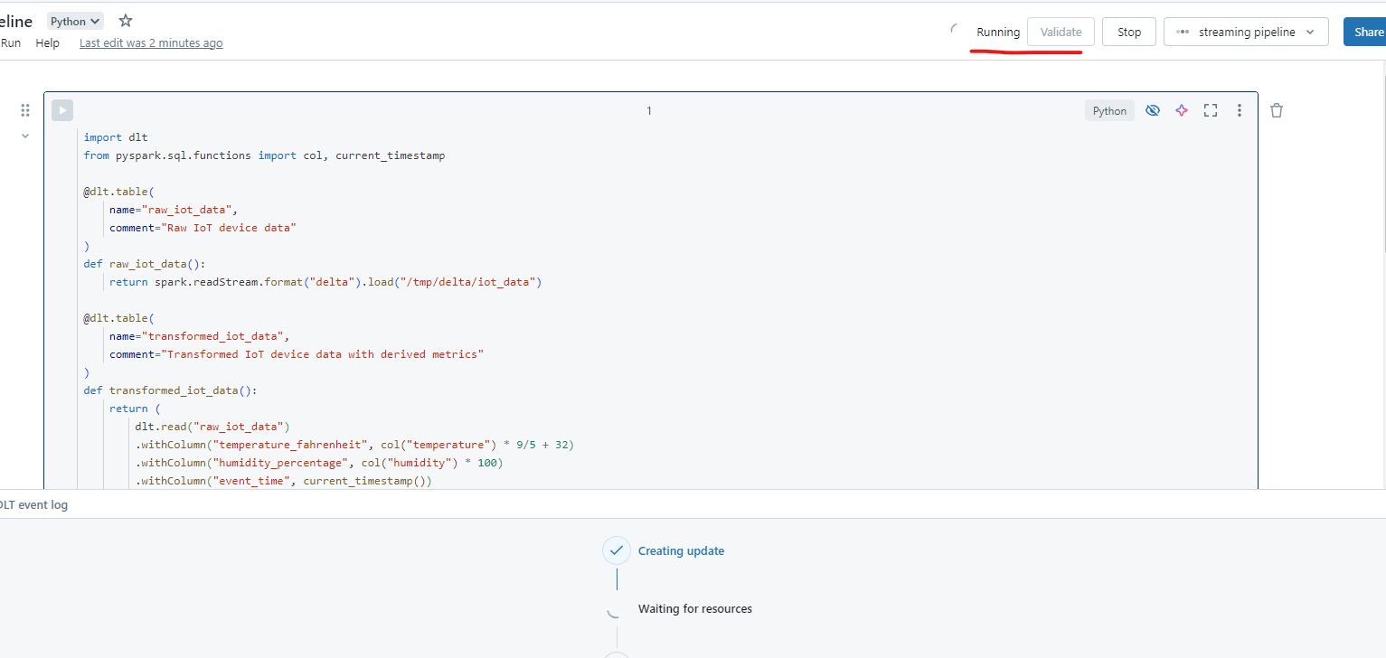
START this pipeline

Slide 65
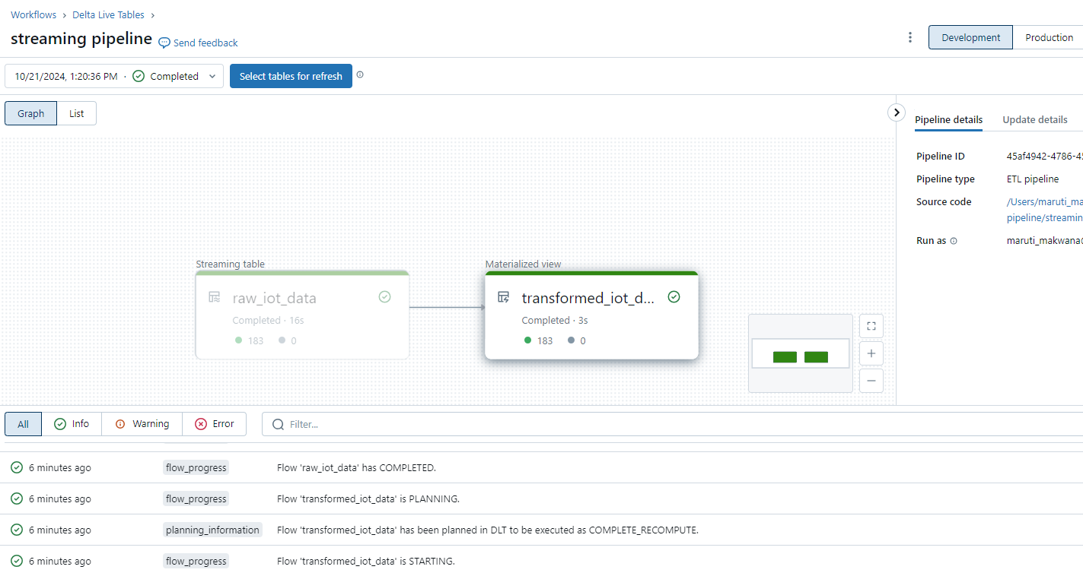

Slide 66
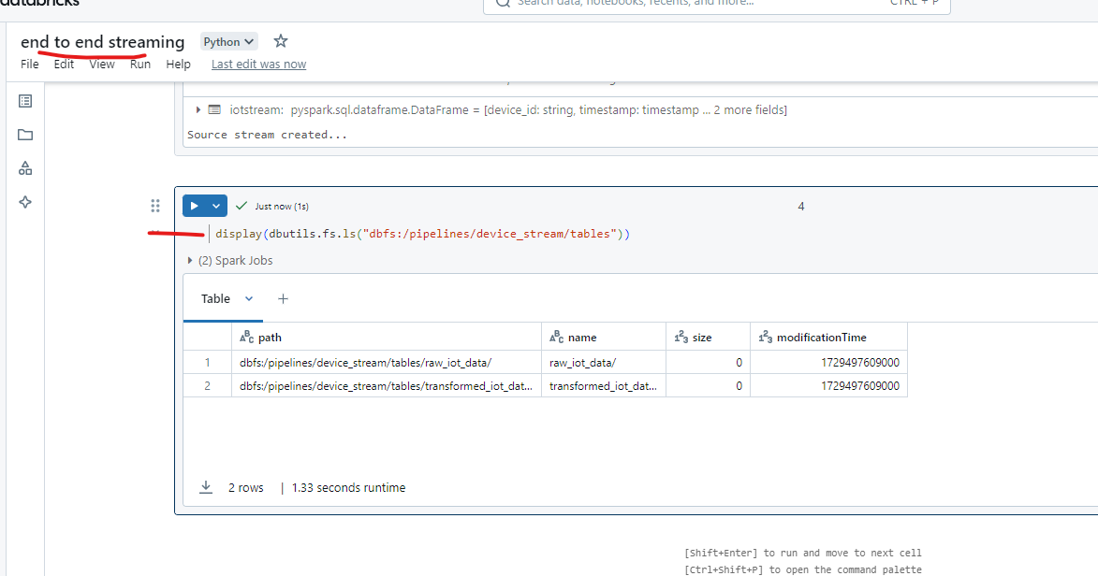
Once the pipeline is successfully executed, go back to the first notebook and verify that the new tables have been created in the specified storage location with the following code:

Slide 67
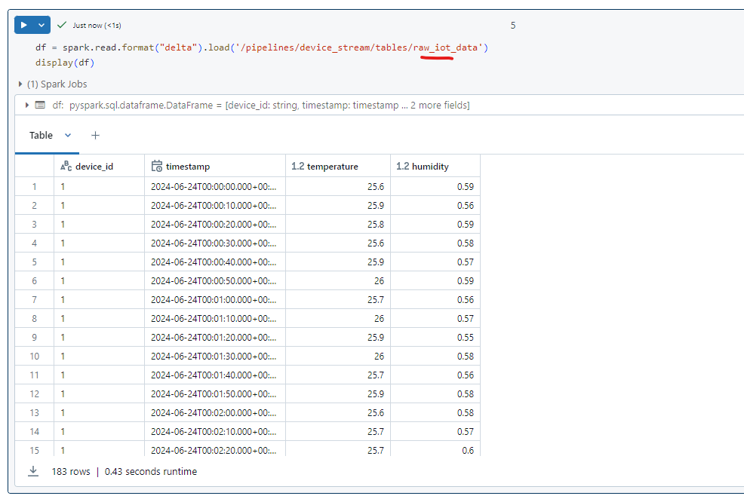

Slide 68
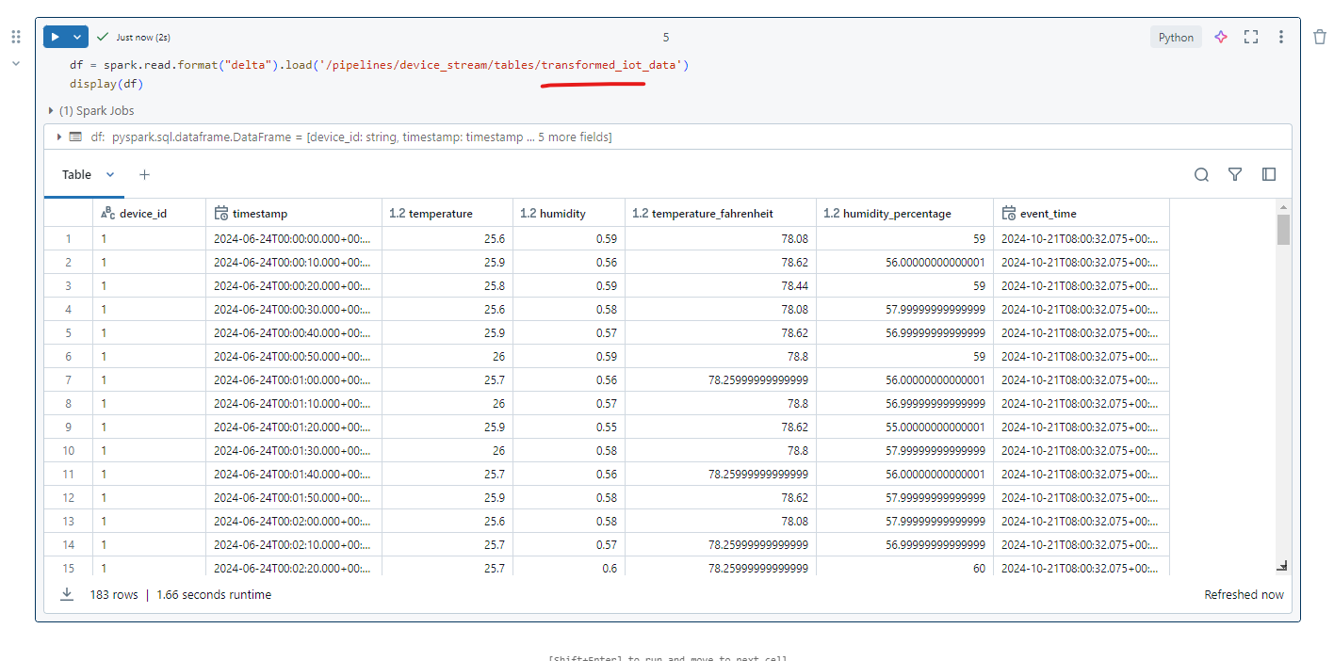
View results as a visualization

Slide 69
